Slide 1
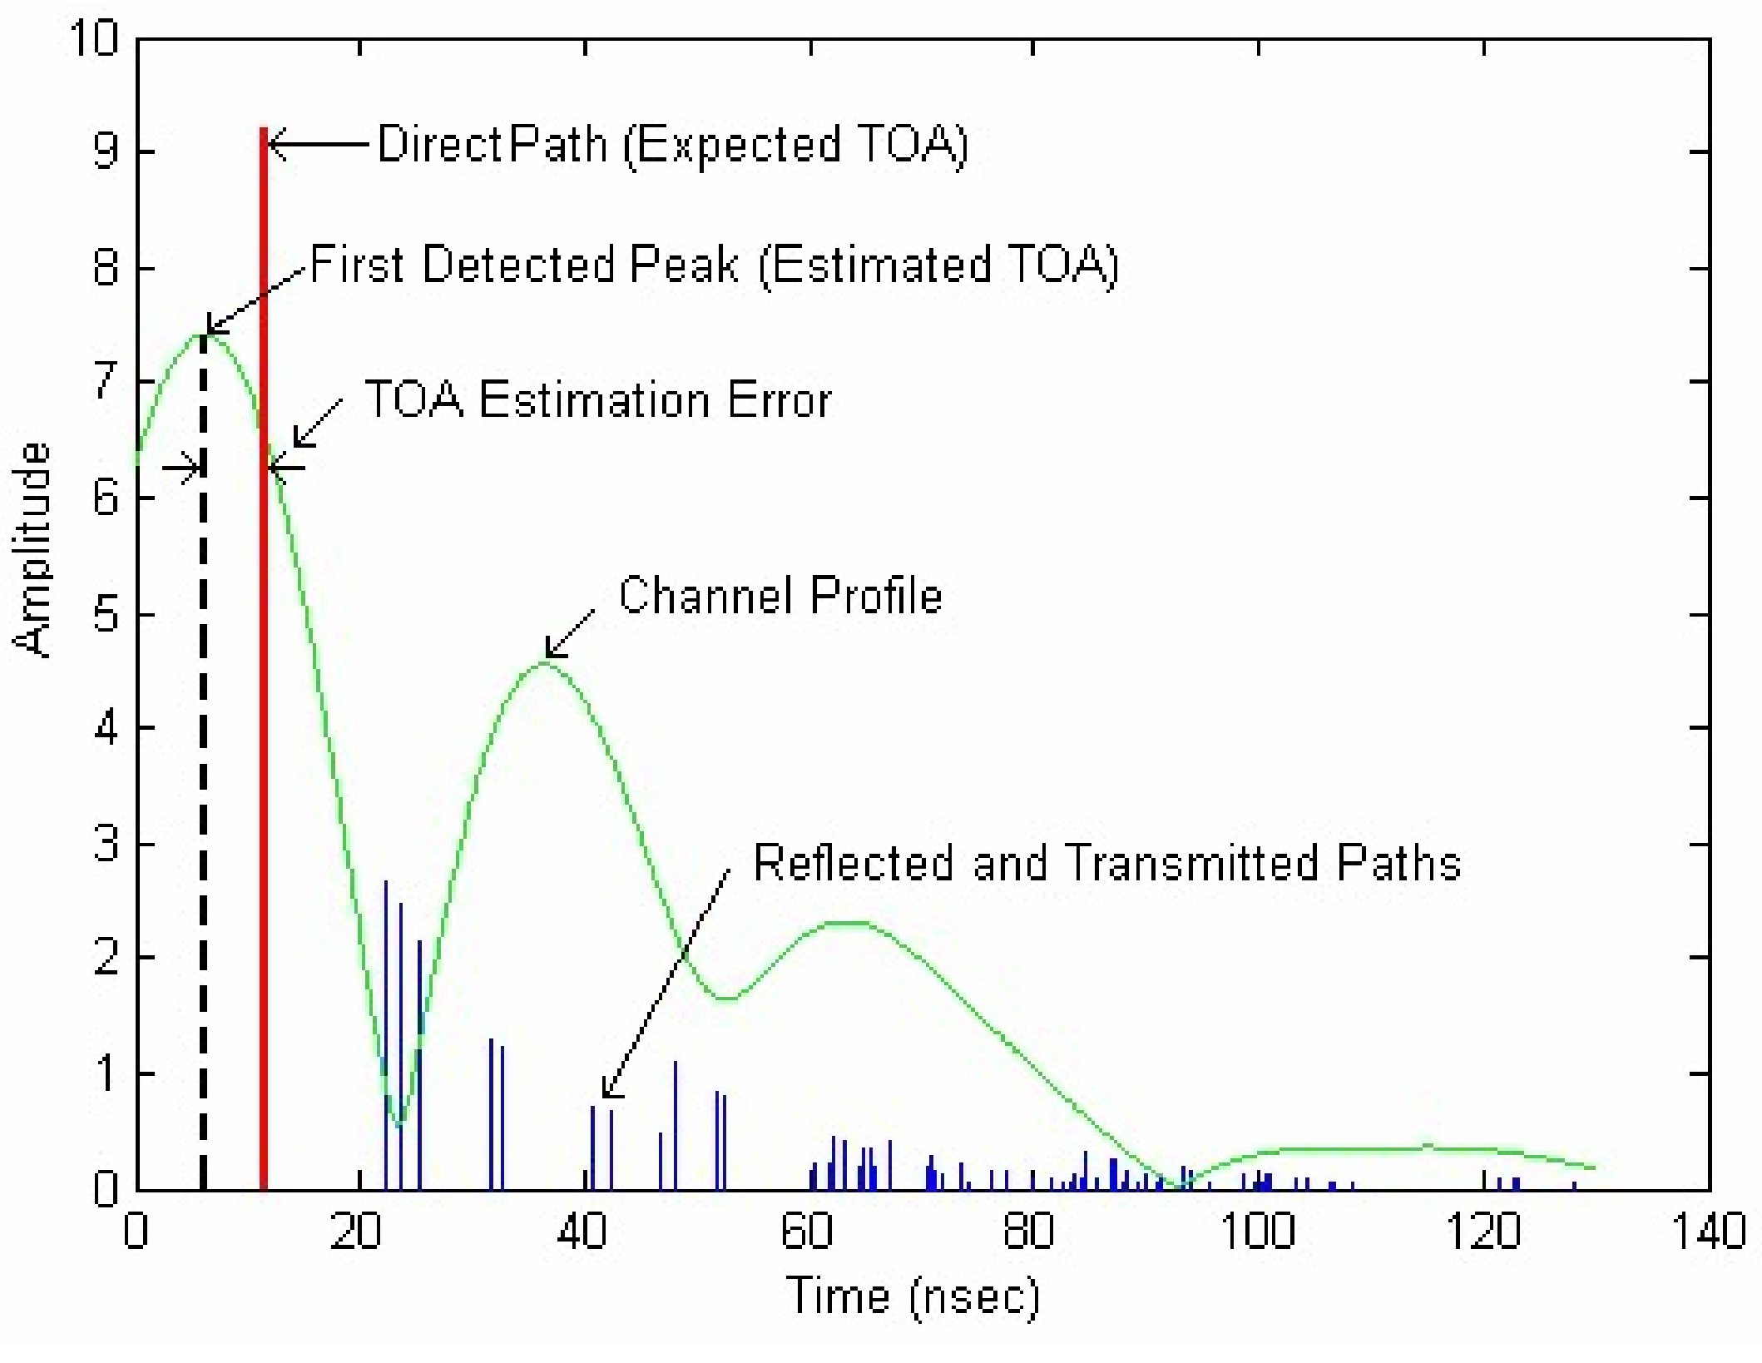



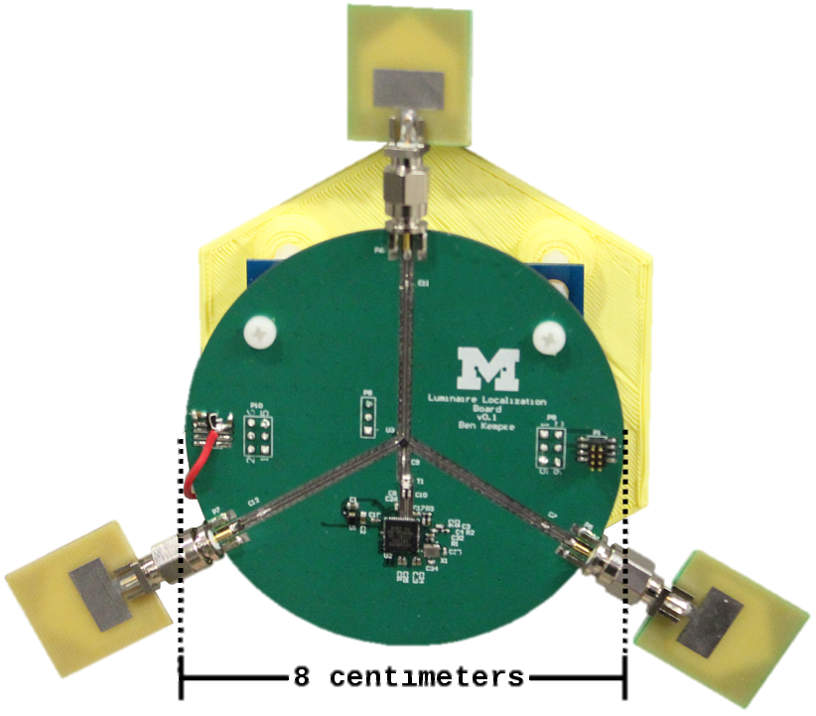
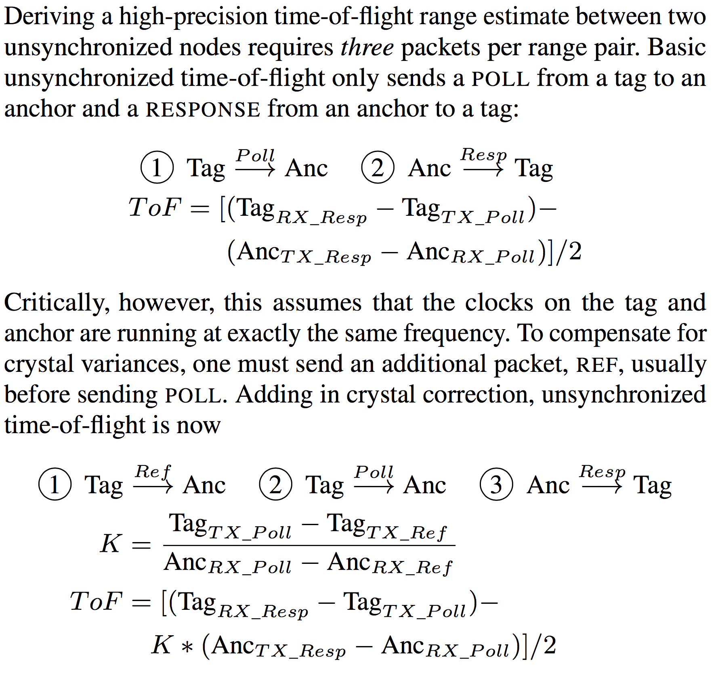
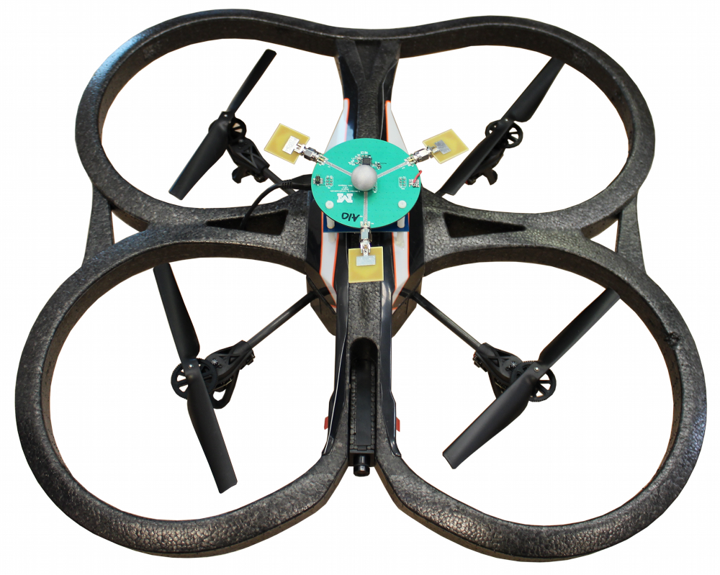
PolyPoint UWB Localization
Wait, What? Demo
The Importance of Indoor Localization
Challenges of RF Indoor Localization
High-fidelity indoor localization could enable a bevy of applications, powering TerraSwarm’s SwarmBox demo today and diverse new possibilities tomorrow. The TerraSwarm project is exploring localization on multiple thrusts including PolyPoint with symmetric ultra-wideband RF, Harmonia with asymmetric ultra-wideband RF, ALPS with ultrasonic, and Luaxpose with visible light.
Many localization systems aim to measure the time of flight between nodes. This presents two issues. First, there must be a line-of-sight path between the
Teaser Pics
two nodes. This is often attainable with careful node placement, such as on ceilings or near lights. Second, however, reflections from walls or obstacles in the room can “blur” the line-of-sight path, making it difficult to estimate the exact time of arrival. At the speed of light, 1 nanosecond of timing error can lead to 30 centimeters of ranging error.
Multipath Pics
Scan to learn more about Luxapose
http://lab11.eecs.umich.edu/projects/vlc_localization/
Scan to learn more about Harmonia
http://lab11.eecs.umich.edu/projects/harmonia/
Graphic from “Distance Measurement Error Modeling for Time-of-Arrival Based Indoor Geolocation”, Ph.D. Thesis by Bardia Alavi
By increasing the utilized bandwidth, the multipath resolution improves, leading to the use of ultra-wideband signals in systems that require high accuracy in indoor environments. PolyPoint leverages the new DecaWave ScenSor UWB transceiver coupled with antenna and frequency diversity to achieve best-in-class RF-only indoor localization.
Scan to learn more about ALPS
http://wise.ece.cmu.edu/redmine/projects/alps/wiki
The PolyPoint Ultra-Wideband Localization System
Tag Architecture and Hardware
Antenna and Channel Diversity Improve Accuracy
PolyPoint nodes consist of a DecaWave DW1000 ScenSor transceiver for data transmission and timestamping, a SKY13317 RF switch and three UWB antennas for diversity, and a CC2538 system-on-chip for protocol orchestration and data offload. PolyPoint uses the same hardware for both the tag and anchors, leading to a simple and symmetric design intended to aid further research in lower-level details such as protocol and hardware design for use in tailored applications.
Novel Ranging Protocol Efficiently Exploits Diversity
Stationary Position Results
Tracking a Fast-Moving Quadcopter in Free Space

